Slide 1
The Fruit Stand Toolkit
Student Driven Healthy Snacks
Edited by Jarrett Stein, Agatston Urban Nutrition Initiative

Slide 2
How the Toolkit Works: Part 1
Adult Resources: This is information adult mentors need to succeed in fruit stand. Review these materials before each fruit stand.
  What is Fruit Stand (4)
  Steps to Starting a Fruit Stand (5)
  Who, Where, When (6)
  Current Operations (7)
  Admin Staffing (8)
  Adult Mentor Job Description (9)
    The Banker Job Description (10)
  Adult Mentor Training (11)
  Student Recruitment (12)
  The Classroom (13)
  10 Tips for Fruit Stand (14)
  Mentor Flow Chart (15)
  What to do with $ (16)
  Student Manager Description (17)
  Student Worker Description (18)
  Fruit Stand Lesson Structure (19)
  Fruit Processing (20)
  Weekly Focus (21)
  Supply Storage (22)
  Junk Food Trade-In (23)
  Employee Snacking (24)
  Profit Decisions (25)
  Problem Solving (26)
  Multiple Disciplines (27)
  Rebel Ventures (28)

Slide 3
How the Toolkit Works: Part 2
Working with the Fruit Stand Crew
  Day 1 Operations Plan (30)
  Introduction (32)
  Our Fruit Stand (33)
  Working As A Team (36)
  Floors and Ceilings (37)
  What/Why Fruit Stand? (38)
  How Fruit Stand (39)
  Operations Plan (40)
  The Jobs
    Accountant (41)
    Sales (42)
    Marketing (43)
    Safety (44)
  The Binder (45)
  The Expense Sheet (46-47)
  Tracking Costs and Sales (48)
    Sales Tracker (49)
    Balance Sheet (50)
  Start Up $ (51)
  Supply Store (52-55)
    Catalog (56-60)
  Hand Washing (61)
  Fruit Processing (62-69)
  Sales/Marketing Plan (70)
    Framework (71-72)
    Ideas (73)
    Disciplines (74)
  Supply Shop Order Form (75-77)
  Safety Detail (78)
  Fruit Stand Sign In (79)
  Jobs During Fruit Sales (80-84)
  Fruit Stand Fact Sheets (85-88)
  Math Practice (89)

Slide 4
What is Fruit Stand?
Fruit Stand is a real-world project-based learning activity. Students learn entrepreneurial skills by running a business that provides access to healthy, affordable snacks to their peers and community.
The Fruit Stand model has many variations dependent on school-specific factors, but in its simplest form can be run 1-day per week with as few as 3 students working together for 1 hour. These students would in turn, through peer education, provide impact throughout their entire school community.
The primary business process of Fruit Stand is washing/chopping whole fruit and selling individual portions of fruit salad. Some Fruit Stands also sell Rebel Bars, smoothies, and apple cider.

Slide 5
Steps to Starting a Fruit Stand
Need is clearly articulated by school community.
Fruit Stand Mentor is identified.
Principal/After-School Director confirms adult and student staffing plan.
Fruit Stand Mentor(s) are trained.
Students are recruited in school.

Slide 6
Fruit Stand- Who, Where, When
Who
  The Fruit Stand team = fruit stand students (manager(s)/crew) + adult mentor(s)
  The fruit stand crew is a small group of adults and students who work together to run the business. The adult mentor(s) could be a parent, college student, or school staff. The main criteria are availability, willingness, and ability to participate. In a single school and in its simplest form, a fruit stand can operate successfully with just one adult mentor and 3 students. This team of 4 individuals can accomplish the necessary tasks to run an efficient and effective fruit stand operation.
  Student participating in fruit stand can come from the same grade or a combination of grades. If there are students from different age groups, make older students responsible for the younger. Usually students are ‘pulled-out’ of a regular scheduled class to participate in fruit stand.
    The Fruit Stand model can engage children from grades 2nd-12th.
    The Fruit Stand model can engage children with a wide variety of learning styles and abilities- from emotional support, to life skills, to mentally gifted students.
Where
  Fruit stand can operate out of any unused space in a school- it has been implemented successfully in classrooms, cafeterias, teacher’s lounges, and gyms. What’s needed is a surface to prepare soup, and some access to a sink and garbage can. The sink doesn’t need to be in the room, but it’s preferred.
When
  The goal of fruit stand is to compete with corner stores before/after school for a share of the student snack market. Although it’s been tried, we have not yet developed an effective strategy to create a ‘before-school’ fruit stand. The barrier of getting willing children and adults is difficult to overcome. Most fruit stands are after-school, either at the end of the school day or the end of an after-school program. The set-up is determined by adult stakeholders (principal, admin team, mentors).
    School Day Schedule (ends at 3pm, after-school is the same schedule but adjusted for the after-school end time)
      Adult mentors arrive at 2pm and set up room
      Fruit Stand students arrive in classroom at 2:15pm
      Fruit Stand team sets up fruit stand at 2:55pm
      Fruit Stand team sells between 3-3:15pm
      Fruit stand team cleans up between 3:15-3:30
      Students leave at 3:30pm
      Adult Mentors leave at 3:45pm after final check

Slide 7
Current Operations
Comegys
  5 days/wk afterschool
  2-5th grade students selected by after-school teacher
  Mentors are Penn student volunteers and after-school staff
  No sink in classroom
  Sell in school hallway at small table
Lea
  5 days/wk afterschool
  5th and 8th grade students selected through improved staffing strategy
  Mentors are Penn student volunteers and after-school staff
  No classroom, students implement fruit stand in cafeteria with other programming
  No sink in cafeteria
  Sell in school cafeteria at metal table
Huey
  5 days/wk school day
  5th grade students selected by school day teacher
  Mentors are Penn student volunteers (after-school staff still being recruited)
  No sink in classroom
  Sell outside in schoolyard

Slide 8
Admin Staffing
Given the scope of our operation, beyond adult mentors the we also have a Fruit Stand Admin team working offsite.
The Fruit Stand Admin team are Penn students working on coordination, planning, and evaluation of the overall program.
  Operations Manager
    Ingredient/Supply purchasing
    Financial Data Analysis
    Leads Mentor recruitment and hiring
      Coordination and scheduling of mentors
      Works to connect at least 1 ‘relational’ and 1 ‘logistical’ mentor for each fruit stand
    Training coordination
      Room reservation
      RSVP, reminders
      evaluation
  Marketing Associate
    Mentor recruitment and hiring
    General issues
    Weekly email
      Scoreboard
      Weekly theme
      Cancellations
      Van schedule
  Research and Development Chief
    Mentor recruitment and hiring
    Reflection tracking and accountability
      Review and Reminders
    Site visits

Slide 9
Adult Fruit Stand Mentor
The Fruit Stand Mentors are the adults who directly oversee students implementing a fruit stand operation on-the-ground at a school.
  Responsibilities:
    Fruit/Supply delivery
    Fruit Stand implementation
    Cost/Revenue tracking
      Fruit/Ingredient re-supply
Mentors are recruited from the following areas:
  University Students: service-learning students, work/study interns, volunteers
  Parents/Family
  School Staff: counselor, emotional support, mentally gifted, food service manager

Slide 10
Adult Role- The Banker
Each week, one fruit stand mentor is The Banker (this can rotate or stay consistent). The Banker is responsible for documenting and entering the fruit stand sales data.
The Banker’s Responsibilities
Take 3 pictures- Expense Sheet, Sales Tracker and Balance Sheet and send to Operations Manager.
Input the following data into Data Tracking google form:
  Total revenue
  Net profit
  Junk Food Trade-Ins
  Overall Fruit Stand Balance
  Fruit, Smoothie, and Rebel Bar Order

Slide 11
Mentor Training
I am a Fruit
Our Fruit Stand Training
Applying ‘Accomplishment of Natural Growth’ to the Fruit Stand model (prior reading is Unequal Childhoods) --- Culturally Relevant Pedagogy, Problem Solving Learning (PSL), Asset Based Perspective
Logistics and Procedures
  Adult roles
    Mentor
      Supply/ingredient procurement
      PSL facilitation
      Data collection
      Efficient communication
    Admin
      Ingredient/supply purchase
      Transportation coordination
      PBL performance management
      Data analysis
  Student roles
Fruit Stand Forms
  Expense Sheet
  Operations Plan
Safety, Hygiene, Organization
  Day 1 (where to go)
    Contact info for staff people
    Pricing fruit and accounting for it
    What do the kids fill it out
      Accounting sheet
      Decision about ordering fruit for the next week

Slide 12
Fruit Stand Student Recruitment
Applications distributed to any students in the selected cohort who are available to participate in fruit stand.
  Separate per job description/ age group:
    Leader
    Crew
  Application has copy of job description, expectations policy, questions, and forms to be filled out and handed back.
    Late Dismissal Consent (parent)
    Photo/Video Consent (parent)
    Teacher/Adult reference (student)
    Questions (student)
The goal of the Fruit Stand recruitment process is to pick a diverse group of students with different personalities and interest, but a similar desire to work on a team and make a difference in their community.

Slide 13
The Fruit Stand Classroom
Key Characteristics of an effective fruit stand classroom:
A sink! At some point, you will need running water to run an effective fruit stand as you’ll be processing whole fruit into fruit salad and frozen fruit into smoothies. Hands get washed, fruit gets washed, knives/cutting boards/bowls get washed.
A safe space to store supplies is extremely important. Supplies that touch food should be kept in a separate, pest-proof container than classroom materials and art supplies.
Chart paper, a white board and dry erase markers, or a blackboard is needed to keep the agenda and create compelling backdrops for engaging education and media. Beyond the surface, you also need the ink, markers, or chalk and eraser. This is where you write the agenda, keep score for games, brainstorm word webs, or do math problems on the fly.
Flat surfaces for cutting. These can be desks (just make sure no one sits while they cut), small/tall science tables (ideal), or a conference table. If you’re able to run fruit stand in the school kitchen with stainless steel tables, consider yourself very, very fortunate.
A trashcan/recycle bin is your friend. There are always paper towels, plastic spoons, and apple cores (although if you can compost, you should compost) getting discarded during fruit stand. These things belong in a bin, not on the floor.
6. A cashbox with a lock is the best way to store money. If you don’t have access to one, then use a gallon ziplock bag or other sealable pouch. Money (beside some petty cash that is kept by the UACS/AUNI staff person in charge) should never be stored at the school, it should always be deposited at the AUNI office within 24 hours.
7. Blank Hats (preferred) or nametags are very helpful to foster community within the fruit stand team. If the fruit stand students will remain stable throughout the semester, they should each get their own hat that they write their name on and can decorate. If hats aren’t available, make nametags (with pins, lanyards, or tape). Tags are also good to make for specific roles so students feel ownership and accountability for their role in the stand session. Address labels make simple nametags.
8. Students work in small groups (Penn and elementary/high) to complete concrete tasks that foster the achievement of the fruit stand goals. This might be washing fruit, calculating fruit stand profit, creating fruit stand posters, or practicing sales pitches and public speaking.
9. Look out for teachable moments while learning by doing. Every aspect of fruit stand is an opportunity for mentorship and positive reinforcement. Set goals, high expectations and provide consistent support to each member of the fruit stand team. The core activities of the fruit stand can be connected to a variety of disciplines (math, writing, public speaking, art/design, business literacy, digital media, etc) and don't be afraid to make these connections.
10. A calm, supportive atmosphere where all individuals on the team understand their roles, how they can seek support, and the expectations for which they are being held accountable.

Slide 14
Ten Tips for Working at the Fruit Stand
Be safe, not sorry. Always keep knives under a close watch to avoid unnecessary injuries.
Never underestimate the importance of sanitation. When in doubt, wash your hands or use hand sanitizer and keep the working area clean.
Keep a close eye on the fruit. If they drop it, they need to wash it.
Always give students responsibility. Teach by asking, not by doing.
Get to know the students’ names as quickly as possible. It’s far more acceptable to ask at the beginning than to ask at the end.
Get the school involved. On a fundamental scale the school can encourage teachers to be proactive about the fruit stand.
While still maintaining authority, establish a genuine, appropriate friendship with the student. This will help you make a true impact on the students’ lives.
Remember that you are there for the students. Always make decisions with this in mind.
Maximize the inherent assets of your fruit stand team and the fruit stand model. Minimize the deficits outside of your control.
Positivity is contagious!

Slide 15
Fruit Stand Mentor Flow Chart
SEPTA Tokens
Pick up 2 SEPTA tokens for each trip to and from your service site
Location: The Netter Center
Rebel Bars
Pick up a marked bag of Rebel Bars and any needed supplies
Location: The Netter Center
Fruit
Pick up a marked bag of fruit
Location: Commons Dining Hall
Supplies (if necessary)
Pick up supplies if notified by the fruit stand admin team
Location: AUNI Office
Student volunteers should follow these steps before traveling to a school for a Fruit Stand session.
Student volunteers should follow these steps after returning from a Fruit Stand session.
Data Tracker
Drop Off
Drop Off the Fruit Stand Sheet and any money collected
Reflection
Fill out the Reflection form, indicating what went well and what could be improved, based on the Fruit Stand session you conducted.
One student from each team (The Banker) fills out the Data Tracker (link found after reflection form), indicating how much was sold and the amount of money collected
Location: UNI Office
Location: Online
Location: Online

Slide 16
What to do with Fruit Stand $
Other than the $5 left in the cash box onsite at the end of each fruit stand, return all other money to the AUNI office within 24 hrs of the fruit stand.
Put the money in an envelope (found on shelf in UNI) with the following written on the front:
  Date of fruit stand
  Fruit stand location
  Total $ in envelope
Put the envelope in the Fruit Stand Safe (Ashley’s office, open 9-5pm).
1/21/15 Huey $21.50

Slide 17
Student Manager Job Description
The most important part of the Fruit Stand manager’s job will be overseeing younger students who will act as the Fruit Stand crew. You will teach these students how to cut, bag and sell the fruit. You will oversee these younger students as they function in the roles of Accounting, Marketing, Sales, and Safety Chief. You will need to be active leaders to control the students and make sure they do their jobs as Fruit Stand workers. A Fruit Stand Mentor will be with you to help guide the students.
Job Responsibilities:
- Arrive on time every day, ready and motivated to work.
- Meet with the Fruit Stand Mentors and Crew to discuss goals.
- Supervise and instruct a crew of 2nd and 3rd graders in Fruit Stand.
- Report and communicate with the Fruit Stand Mentors on a weekly basis.
- Answer questions about the different roles in Fruit Stand.
- Engage workers in a multitude of games, activities and conversations relating to Fruit Stand.
- Communication with the Fruit Stand Mentors if you have to miss work.
Job Requirements:
- Must be willing to stay at Comegys until Fruit Stand closes at 5:50pm
- Ability to be a team player and work independently
- Strong work ethic, creativity, and passion for good food
- Dedication to the mission of Fruit Stand
- Leadership ability and decision-making abilities

Slide 18
Student Worker Job Description
The most important part of the Fruit Stand Crew’s job is to cut, bag and sell the fruit. The crew will work with other students to create a fruit stand that works efficiently and professionally. The crew will be made up of a few different roles such as: Loud Mouth, Cashier, and Security Guard. A successful Fruit Stand can only exist if all of these roles can work together in complete harmony. Each fruit stand will be assigned one day to be open for business and each fruit stand will compete against the other days.
Job Responsibilities:
- Arrive on time every day ready and motivated to work.
- Meet with the Fruit Stand Mentors and Crew to discuss goals.
- Cut, bag, and sell fruit and other foods.
Fill the role of Loud Mouth, Cashier, and Safety Chief as necessary.
Job Requirements:
- Must be willing to stay at Comegys until Fruit Stand closes at 5:50pm
- Ability to be a team player and work independently
- Strong work ethic, creativity, and passion for good food
- Dedication to the mission of Fruit Stand

Slide 19
Fruit Stand Lesson Structure
Operations Plan
  Roles
  Goals
  Pros and Grows partners
Fruit Processing
  Weekly Focus
  Role breakout
    PSL
Fruit Stand Setup and Sales
  Role breakout
Fruit Stand Cleanup
  Pros and Grows

Slide 20
Fruit Processing
Sales, Marketing, and Security begin washing, counting, and cutting fruit
  If other products are being prepared for fruit stand, students divide their responsibilities to make sure everything is prepared for selling on time.
Accountant records records fruit (and any other product) data on Expense Sheet (inventory)
  Refer to Operational Plan for price per fruit
  Cut each fruit into individual pieces
  Count out each grape
Use division to calculate price per individual piece
Accountant adds data to the Expense Sheet.

Slide 21
Fruit Stand Weekly Focus
The Business Plan
  Mission
  Social entrepreneurship
  Goal setting
Accounting skills
  Expenses, Revenue, and Profit
4 P’s
  Price
  Product
  Place
  Promotion
    Selling skills
    Public speaking
    Persuasion

Slide 22
Supply Storage
Cleaning and Inventory of supplies is the responsibility of each Fruit Stand team.
There is one ‘Master Bin’ that has basic supplies (cutting boards, bowls, etc) that all fruit stand teams share.
Each fruit stand team also has their own individual bin for plastic bags, the fruit stand binder, signs, and individualized fruit stand purchases (like blenders).

Slide 23
The Junk Food Trade In
The Urban Nutrition Initiative (also called UNI, the organization that oversees fruit stand) believes that everyone should have the choice to purchase a healthy snack.
Customers who have an unopened junk food (like a bag of chips, full size candy bar, honey bun, Hugs, etc) can exchange this to the Fruit Stand and receive a bag of fruit, Rebel Bar, or smoothie in return. UNI will reimburse the Fruit Stand $.50 for the cost of this sale.
All junk food trade-ins should be documented on the Sales Tracker and given to a Mentor.

Slide 24
Employee Snacking Policy
It is up to the discretion of the Fruit Stand Crew to determine the employee snacking policy. Here are some options.
  All Fruit Stand workers get one bag of fruit at the end of fruit stand (this will decrease profit the most).
  Fruit Stand workers get a discount on fruit (this will decrease profit some)
  Fruit Stand workers get to share any extra unsold fruit (this does not decrease profit)
  And many other variations and possibilities.

Slide 25
Fruit Stand Profit Decisions
Who makes the decision?
  Throughout fruit stand Adults facilitate conversation about purchasing for the next week.
  The Sales position is responsible for taking the lead in starting these conversations.

Slide 26
Problem Solving
The entire Fruit Stand crew should be actively engaged throughout the activity. Within each student role, there is ample opportunity to think creatively and add value to the fruit stand.
Encourage students by asking questions. Think about how you can make your fruit stand better and what problems you can solve.
  What do you know? What do you need to find out?
  Who do you know? Who don’t you know that can help?
Mentors are responsible for supporting students participation in actively solving problems and creating a successful fruit stand and healthier school.

Slide 27
Multidiscipline Curriculum Connections
Math
  Financial literacy
  Graphing
Reading/Writing
  Social enterprise research
Cultural Studies
Science
Art
Technology

Slide 28
Rebel Ventures Integration
Social Enterprise video
  RV a business selling healthy snacks. We work 3 days a week after-school in a professional kitchen on 48th and Pine.
  Our mission at Rebel Ventures is to bring healthy back to the streets. We are young people in Philly creating good food for young people in Philly. We want our community to have access to foods that will help us learn better in the classroom and play better on the field. Like all businesses, we to work hard to sell products to make money. Still, our primary purpose is to create a healthier community.
  How does this relate to fruit stand?
  RV is a social enterprise because we aren’t only trying to make money, we are also trying to make our community a better place. Fruit Stand is also a social enterprise.
  What makes fruit stand a social enterprise?
Financial Literacy
  What are costs/expenses, sales/revenues, and profit?
How to sell a Rebel Bar

Slide 29
Day 1 Plan
Name Tags
I am a FRUIT or VEGGIE
Operations Plan
Our Fruit Stand
Why Fruit Stand?
How Fruit Stand?
  How does a business make money?
    Profit = Revenue-Cost
      Fixed Cost: tools
      Variable Cost: supplies/ingredients
      Fruit Stand Expense Tracking Sheet
  Budget
    Begin with 1 of each of the following items (the Start Up Package):
      Metal bowl, cutting board, lettuce knife, apple slicer, dish tub, sandwich bags
      Soap, Bleach, Trial Fruit, Trial Rebel Bars
    Fruit Stand also begins with $10 of start up funds
  Mock Fruit Stand
    Learn per unit price of each fruit
    Divide each fruit into individual pieces
      Orange slice = $/orange / # slices/orange
      Apple/Pear slice = $/apple / # slices/apple
      Individual grape = $/lb x total lbs grapes / total # grapes
    Price each fruit by piece, then full mixed fruit serving
Using fruit, rebel bar, supply, and tool price list, decide what to purchase for the following week.

Slide 30
Introductory Activities
Make nametags with printer labels.
My name is _______, and I am a type of fruit.
  I am sometimes red, and sometime green.
  I grow on a vine.
  I have an edible skin.
  I am delicious fresh or frozen.
  Usually I don’t have seeds.
When a person guesses the fruit, they become a new fruit. After everyone gets to play, the game ends.

Slide 31
Our Fruit Stand
Everyone gathers in a circle.
On a piece of Chart Paper, draw an outline of a big piece of fruit.
The Fruit Stand Crew is working together all semester to be the best fruit stand in Philly. What do we need to do for Our Fruit Stand to be the best?
  Write these things in the middle of the fruit (if appropriate, students can write themselves).
What types of things will cause Our Fruit Stand to fail?
  Write these things on the outside of the fruit.
Everyone signs the chart paper.

Slide 32
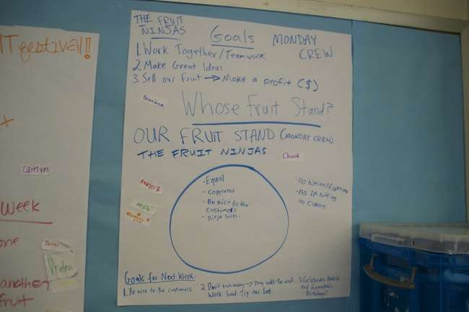

Slide 33
How Can We Work As A Team?
Below are expectations that all participants (students and adults) working with the Agatston Urban Nutrition Initiative agree to.
Define each of the below expectations and how they fit into fruit stand.
One Mic
Try It On
Step Up, Step Back
Use I Statements
Move With Urgency
Find A Need And Fill It
Leave Spaces Cleaner Than You Found Them
We hold ourselves accountable to our teammates by working directly with a ‘Pros and Grows’ buddy each week. You and your buddy will look after each other and at the end of each fruit stand, give honest feedback on something you did well and something you can improve on.

Slide 34
Fruit Stand Floor, Fruit Stand Ceiling
The Floor is the foundation of fruit stand. It is what holds us steady as we create a healthier community. If our floor isn’t sturdy, fruit stand will fail.
An issue unresolved in Pros and Grows should be addressed with an Adult Mentor. If it is about an Adult Mentor (and there isn’t another Mentor to tell), it should be addressed with a teacher/staff at the school.

Slide 35
What is Fruit Stand?
What is a business?
  What is a social enterprise? (more advanced)
Are there other fruit stands?
  Yes, at this school and at others (Lea, Huey, Comegys). We are in a competition with the other fruit stands to see who can sell the most fruit and make the most money.)
Why Fruit Stand?
What is our mission? Why?
  What does food do for our body?
  What does food do for our environment?
  What does food do for our economy?

Slide 36
How Fruit Stand?
Fruit Stand goal setting, role explanation and sign-up on Operations Plan.
  What is a goal?
  What is a role?
    Accountant
      Responsible for keeping track of and filling out the Expense Sheet.
    Marketing
      Responsible for executing the Sales and Marketing Plan.
    Sales
      Responsible for executing the Sales and Marketing Plan.
    Security
      Responsible for implementing the Security Detail.
    Manager (Optional)

Slide 37
Operations Plan
The Operations Plan is an agenda written on chart paper that contains the following information:
Team Roles
    Crew sign up first, then manager
  Pros and Grows partners
Budget Report
  Overall profit/loss
  Previous week profit/loss
Goals
Ingredient Inventory
Expense Tracking

Slide 38
Operations Plan
Crew Sign In:
_____________
_____________
_____________
_____________
_____________
_____________
_____________
Roles/Tasks:
_____________
_____________
_____________
_____________
_____________
_____________
_____________
Daily Goal:
_________
Last week’s Profit/Loss:
_________
This week’s cost:
_________
This week’s revenue:
_________
This week’s profit/loss:
_________

Slide 39
Accountant
Before Fruit Sales
Count all Fruit, Smoothie Ingredients, and Rebel Bars and document on Operations Plan and Expense Sheet
Determine cost of each piece of fruit (and price of smoothie, if applicable).
During Fruit Sales
Fill out the Sales Tracking sheet.
Make sure the Fruit Stand table is attractive and well organized.
After Fruit Sales
Complete Expense Sheet filling in the expenses from the Operations Plan and revenue from sales.
Help clean up Fruit Stand supplies.
Use this information to help determine how many pieces of each fruit should go into a single serving bag, and what to price the fruit bags and smoothies at.
Update the Fruit Stand Balance sheet.

Slide 40
Sales
Before Fruit Sales
Support washing, chopping, and bagging of fruit.
Work with Marketing to complete the Sales/Marketing Plan.
During Fruit Sales
Operate the Cash Register.
Make sure the Fruit Stand table is attractive and well organized.
After Fruit Sales
Help clean up Fruit Stand supplies.
Practice Fruit Stand Math.
Gives Sales report and determines purchasing for Fruit Stand with The Banker.
If necessary, order materials from the supply store.

Slide 41
Marketing
Before Fruit Sales
Support washing, chopping, and bagging of fruit.
Work with Marketing to complete the Sales/Marketing Plan.
During Fruit Sales
Makes sure everyone in the school knows that Fruit Stand is open.
After Fruit Sales
Help clean up Fruit Stand supplies.
Create advertisements, posters, social media, etc.

Slide 42
Safety
Before Fruit Sales
Support washing, chopping, and bagging of fruit.
Ensures Fruit Stand production area is safe and sanitary.
During Fruit Sales
Prevents loss and theft during Fruit Stand sales.
After Fruit Sales
Helps clean up Fruit Stand supplies.
Completes Sign-In sheet.
Maintains orderly and fun environment during Fruit Stand sales.
Completes Fruit Stand Inventory check.

Slide 43
The Fruit Stand Binder
Each school has a fruit stand binder that contains the following documents:
  Sign In (multiple copies)
  Store Catalog (laminated)
  Shopping List (multiple copies)
  Expense Sheets (multiple copies)
  Inventory (laminated)
    Baseline with space for new items
  Operations Plan Template (laminated)
  Sales Tracking sheets (multiple copies)
  Sales and Marketing Plan (laminated)

Slide 44
The Expense Sheet: Costs and Sales
A business needs to make money to sustain itself. The money is business makes is called sales. Another word for sales is revenue.
  How does the fruit stand make money?
  How does ______ (any business) make money?
A business needs to make money because it costs money to run a business. The things a business buys are called costs. Another word for costs is expenses.
  What are the fruit stand costs?
  What are the costs of ________ business?
  Depending on comprehension of fruit stand students, here you can go into detail about fixed costs (cutting boards, knives, bowls) and variable costs (fruit, plastic bags, paper).

Slide 45
Expense Sheet
= cost of (fruit + supplies + smoothies/snacks)
Filled out by Accountant
= $ from (fruit + smoothies + snack sales)
= (fruit stand revenue – total cost)

Slide 46
Tracking Costs and Sales
Why is important to keep track of fruit stand costs? Sales?
  How can we keep track?
The Operational Plan will allow the Fruit Stand team to track expenses throughout fruit stand.
Entering data on a standard Expense Sheet will keep the tracking of costs/sales organized.
Each Fruit Stand the Accountant will fill out the Operational Plan, Expense Sheet, Sales Tracker, and Balance Sheet.

Slide 47
Sales Tracking
Date
______
Total Fruit
______
 | Fruit (tally each sale) | Smoothie (tally each sale) | Snack (tally each sale)
Student
Adult
Total Smoothie
______
Instructions:
Write a tally mark for each sale.
Write a circle for each coupon.
Write an X for each junk food trade-in.
Total Snack
______
Total Coupons ______
Total Junk
______

Slide 48
Fruit Stand Balance Sheet
Date | Overall Balance | Revenue | Cost | Profit/Loss | # of junk food trade-ins
START | +$10

Slide 49
Start Up Money
The money your business starts with is called ‘start up capital’. Your start up capital is $10.
  With this capital you can purchase whole fruit, smoothie ingredients, and plastic bags.
Along with the money, you also start the fruit stand with supplies to help you run fruit stand. These supplies are called fixed costs because you don’t need to buy them over and over again (unless they break).
  You can also buy more supplies with your start up capital and/or future fruit stand profits. You can then rent these supplies to other fruit stands.
  All available supplies can be found at the Fruit Stand Supply Shop.

Slide 50
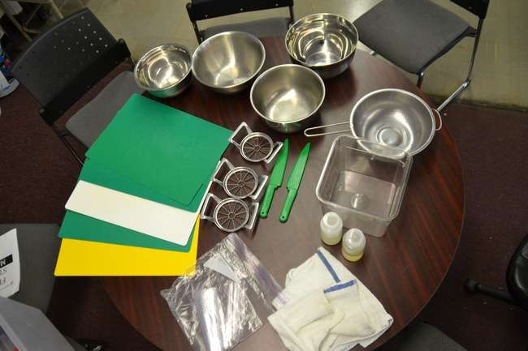
Supply Store
Metal Bowl = $1
Colander = $2
Apple Slicer = $2
Cutting Board = $1
Square Bucket = $2
Lettuce Knife = $2
Soap/Bleach Bottle = $1
Dish Towel = $.50
Sandwich/Gallon Bag = $.01/.02

Slide 51
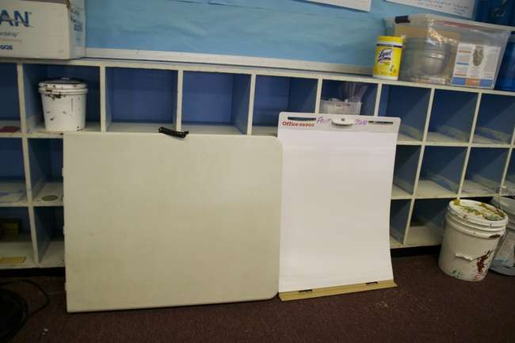
Table = $10
Chart Paper = $.05

Slide 52
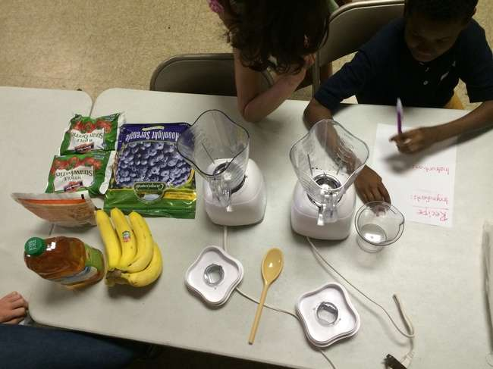
Blender = $5
Wooden Spoon = $1

Slide 53
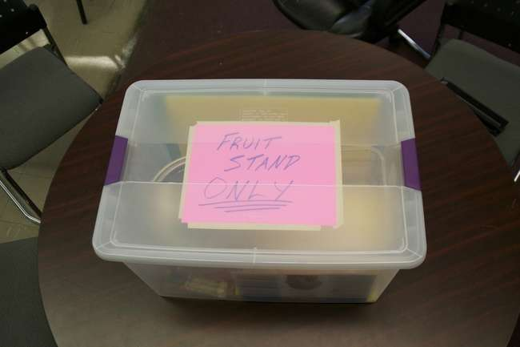

Slide 54
Supply Store Catalog

Slide 55
Descriptions
Sandwich/Gallon bag = $.01/.02
A necessary item that can be used to package everything from processed fruit to popcorn.
Dish Towel = $.50
Clean or dry tables, bowls and other wet items even quicker with extra dish Towels.
Cutting Board = $1
Need to cut more fruit but there are not enough clean surfaces? Try purchasing an extra cutting board or two!
Metal Bowl = $1
Metal bowls can be used to store sliced fruit before it is packaged. They can be great for popcorn too!
Soap/Bleach Bottle = $1
Soap and bleach are important for cleaning surfaces and keeping your fruit stand up to health code standards. Try using soap and bleach conservatively before purchasing.
Apple Slicer = $2
Do your customers love apples?! A new apple slicer can help your business process more apples even faster.
Colander = $2
Make washing fruits even easier with the addition of an extra colander or two!
Lettuce Knife = $2
An extra knife might be a good idea to get oranges cut even faster. Consider purchasing a knife along with a new cutting board.
Square Bucket = $2
What can you do with a square bucket?! Well, almost anything really. These are bigger than the metal bowls and can be used to hold fruit or soapy water for cleaning.
Marketing Materials
Chart Paper $.05
Sales/Marketing will find chart paper useful as large posters for advertising. Try writing the daily prices or special items that your fruit stand offers.
Additional Table = $10
An extra table is definitely one of the more expensive items at Mr. Sam’s Supply Store, but its benefits are numerous! For instance, more table space means more items can be displayed at your fruit stand.
Specialty Equipment
Smoothie
Blender = $5
Wood Spoon = $1
Popcorn
1 pound of popcorn = $.80
Salt = $1
Olive Oil (liter) = $2
Popcorn Maker = $5
Hot Apple Cider
1 Gallon of Cider = $.80

Slide 56
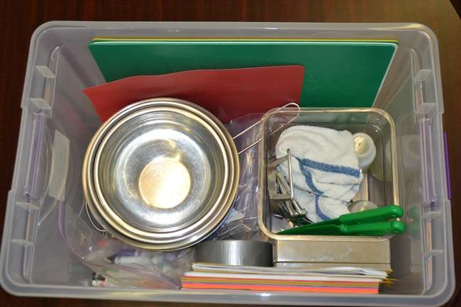

Slide 57
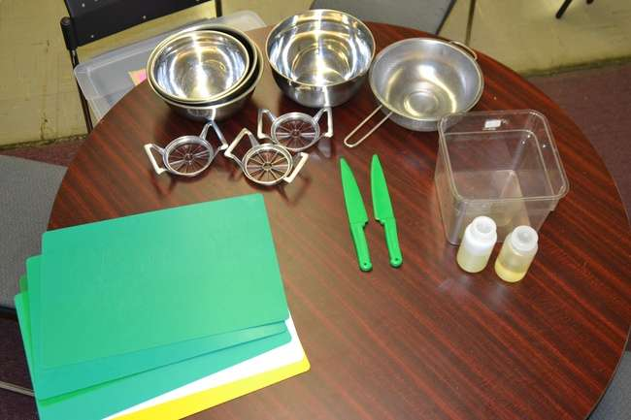

Slide 58
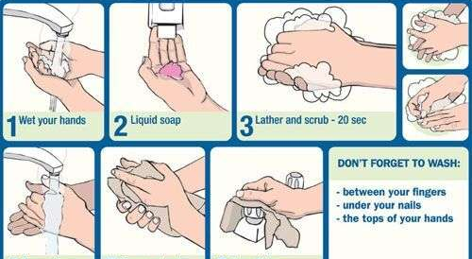
HANDWASHING

Slide 59
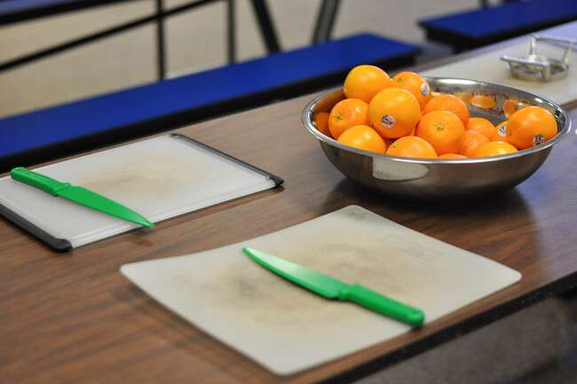
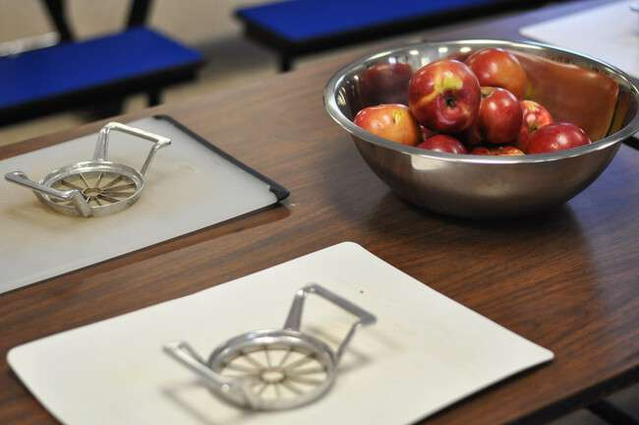
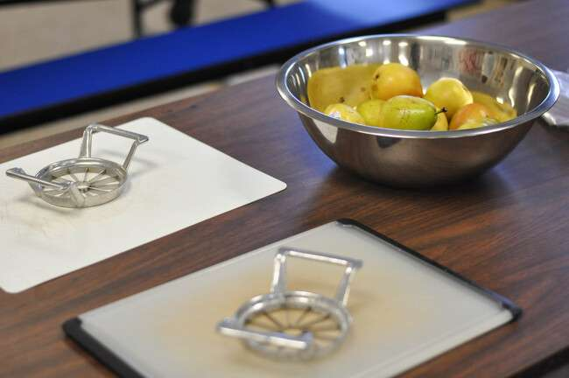
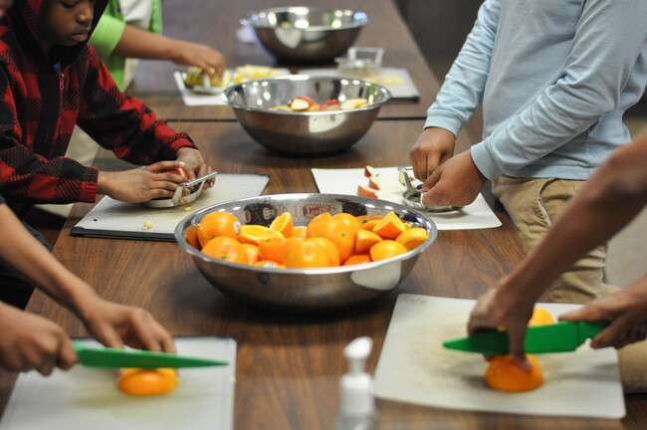
Table Layout: Fruits should be placed in metal bowls according to type. This will ensure that the cutting and bagging process is orderly and efficient.
Fruit Processing

Slide 60
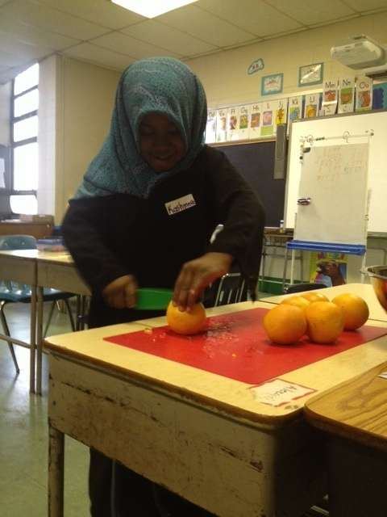
  Pre-sliced fruit increased sales by 71% vs whole fruit
  Students consuming over half of fruit selected increased 73%
  Students wasting over half of fruit selected decreased 48%
  Wansink, B. et al (2013) Pre-Sliced Fruit in School Cafeterias: Children’s Selection and Intake

Slide 61
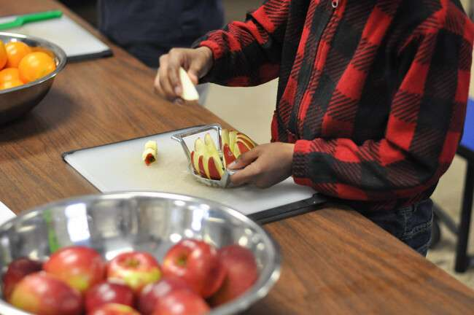
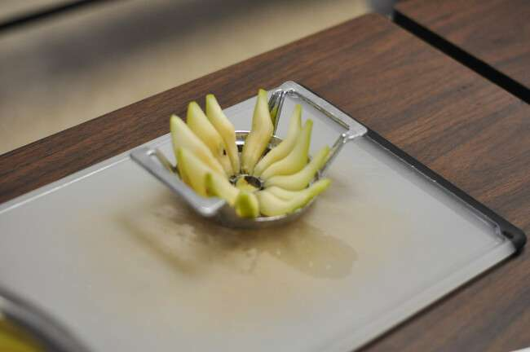
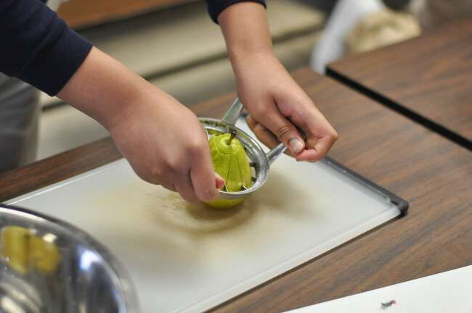
Cutting Apples & Pears: Apple cutters are used to core and divide each apple and pear into ten equal parts.

Slide 62

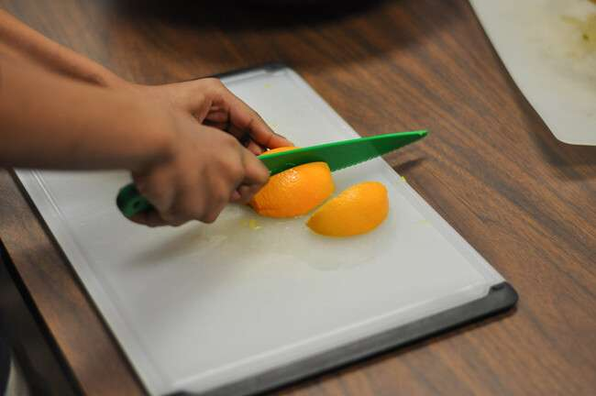
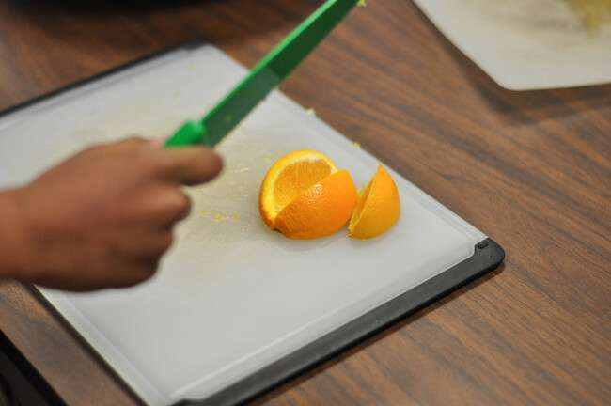
Cutting Oranges: Six orange slices can be obtained from each orange. The fruit is firstly cut in half, and each half is subsequently split into three equal wedges.

Slide 63
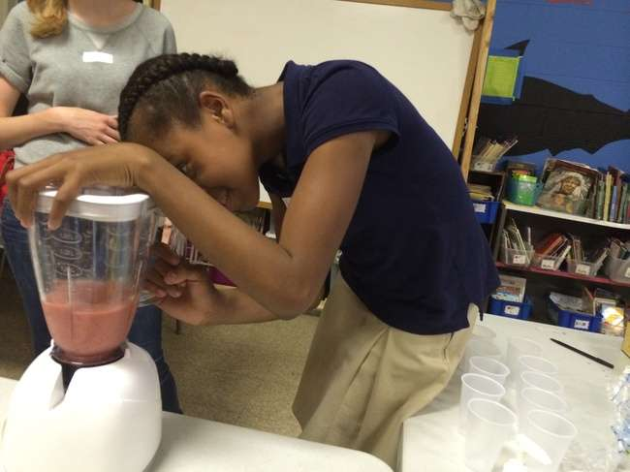

Slide 64
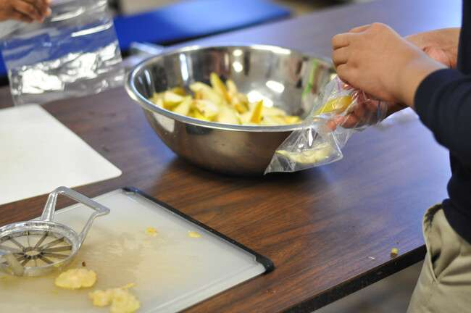
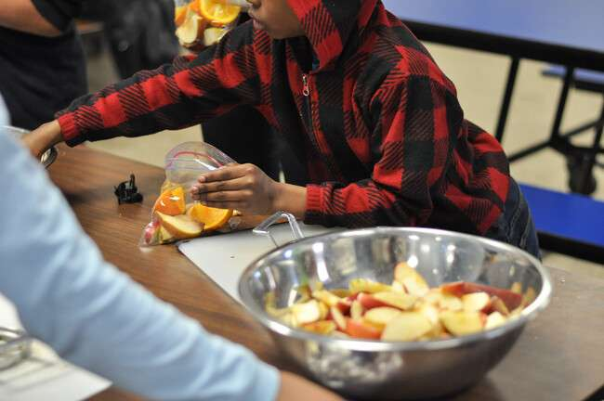
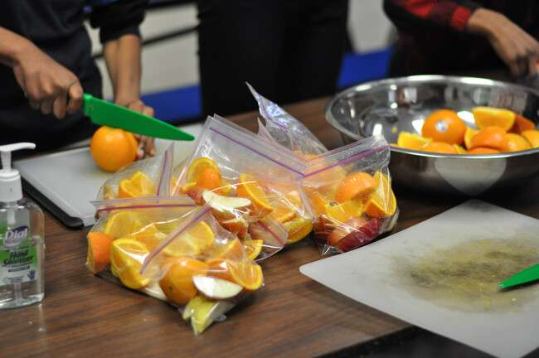
Bagging Fruit: An assembly line is created, ensuring that the bagging process is again orderly and efficient.

Slide 65
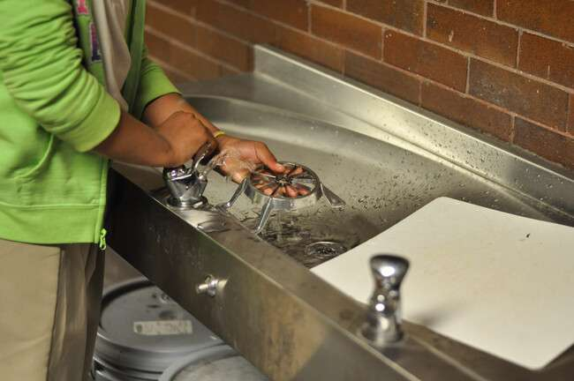

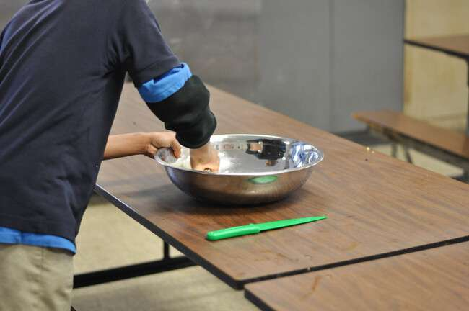
Cleaning Up: Students clean up prior to selling fruit, placing clean and dry materials back into the Fruit Stand Bin, ready for tomorrow’s Fruit Stand.

Slide 66
Sales and Marketing Plan
The Sales and Marketing positions at fruit stand can work together on projects during fruit processing (after fruit bags are prepared), and split up after fruit stand opens for business.
These positions can also split up and work on separate projects.
  Sales: review Fruit Stand Catalog and fill out Shopping List
  Marketing: Design and Create Marketing Materials

Slide 67
Framework for Sales/Marketing Projects
What is the goal?
What are our strengths? What are our weaknesses? Opportunities? Threats?
How can we maximize our strengths and opportunities to minimize our weaknesses and threats?
What don’t you have that you need, and how will you get it?

Slide 68
Ideas for Sales/Marketing Projects
  Increase Fruit Stand Awareness
    Create posters for hallways and bulletin boards
    Spread the Fruit Stand word on social media
    Announcements on the PA system (Principal Permission Required!)
    Classroom Visits (Teacher Permission Required)
    Design Advertisements to print in school newsletter
    Fruit Stand Stickers (use printer labels)
  Increase Fruit Stand Attractiveness
    Create Price Signs for Fruit Stand Table
    Research Fruit Stand Design improvements
      Tablecloth
      Bowls, baskets
    Design Fruit Stand uniforms
      Hats, aprons etc

Slide 69
Sales and Marketing by Discipline
Writing/Reading
  Fruit stand announcements
  Social media
  Storyboard
  Partnership email
  Journaling
  Competition research
Math
  Graphing expenses, revenues, and profits
  Analyzing sales by customer demographics
Science
  Nutritional analysis of fruit stand and competitive foods
  Research and development
Art
  Posters, signs advertising fruit stand

Slide 70
Supply Store Order Form

Slide 71
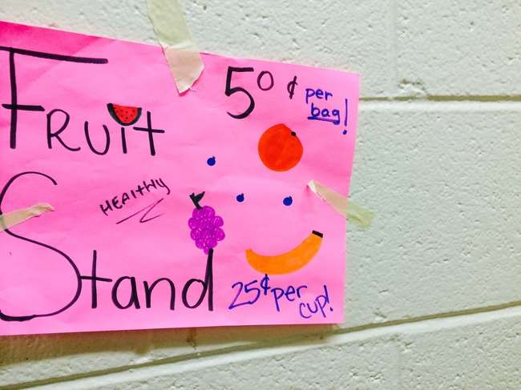

Slide 72
Safety Detail
Inventory
Cashbox
Safety and Hygiene
Personnel Tracking
  Sign In Sheet with Role
    Use ops plan as reference

Slide 73
Jobs During Fruit Sales
Accountant
  Enter customer data on Sales Tracking Sheet
Sales
  Cashier: handle all fruit stand transactions
Marketing
  Loud Mouth: make sure everyone in the school knows that fruit stand is happening
Security
  Make sure everyone is standing in a calm line
  Regularly check the Fruit Stand Table Display to make sure it is attractive and organized

Slide 74
Fruit Stand Sign In
Mentor: _______________
Mentor: _______________
Mentor: _______________
Mentor: _______________
Mentor: _______________
Date: ___________
Mentor Leader: _______________
Student Name | Role | Time In | Time Out | Buddy

Slide 75
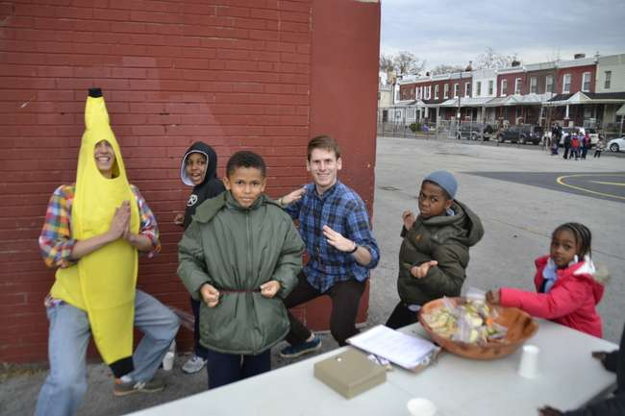

Slide 76
